Slide 1
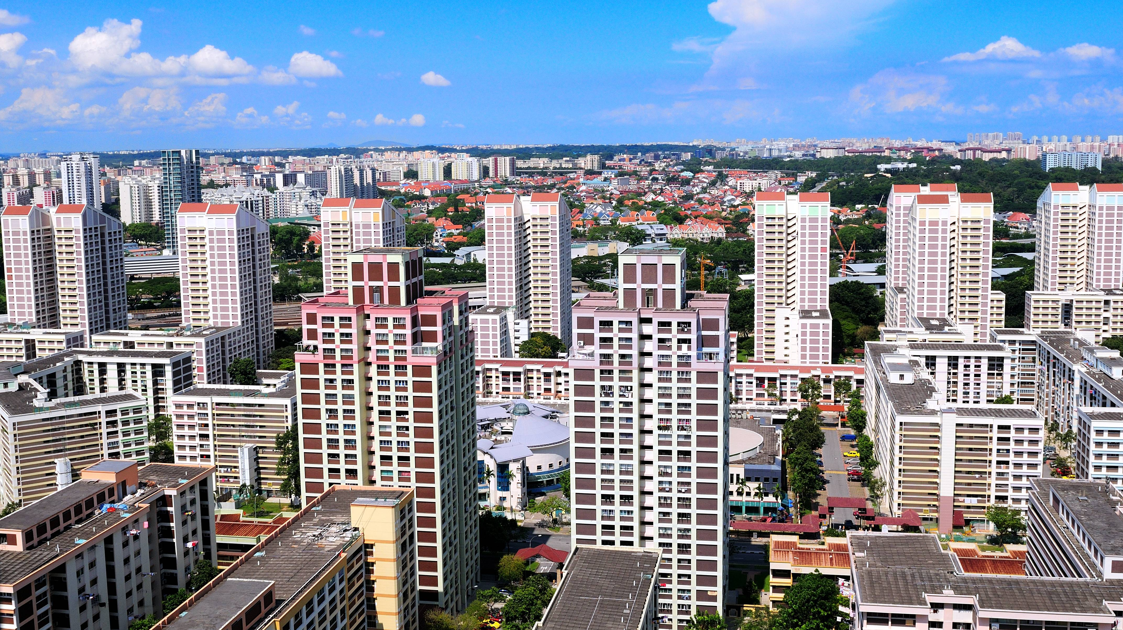
Resale Flat
Unsupervised Machine Learning
Mini Project 2
Kelvin Liew
27th April 2022

Slide 2
Overview – Unsupervised Machine Learning
Input Raw Data
Algorithm
Output
Data Source:
data.gov.sg/dataset/resale-flat-prices
K-means
DBSCAN
Unknown output
No Training Data Set
Data Information
Interpretation
Processing
Title: Resale Flat Prices
Description: Resale transacted prices from 1990 to 2022 onwards
Publisher: Housing and Development Board
Dataset: 870,417 rows & 11 features
Unsupervised learning is used when the problem requires a massive amount of unlabeled data.
The model can identify the patterns
Discover the underlying patterns and structures of a data set
Typical algorithms include clustering, dimensionality reduction, and anomaly detection.
Notes:
The prime reasons for using Unsupervised Learning
finds hidden patterns or groupings in unlabeled input data
It is easier to get unlabeled data than labelled data, which needs manual intervention
It finds all kinds of unknown patterns in data
Help to find features which can be useful for categorization
Clustering Types
Hierarchical clustering
K-means clustering
K-NN (k nearest neighbours)
Principal Component Analysis
Singular Value Decomposition
Independent Component Analysis

Slide 3
Approach
Conclusion and Recommendations
Problem Statement
Unsupervised Machine Learning
Data Modeling
Data Collection
Data Clearing & Exploratory Data Analysis
Notes:
To translate a business idea or question into a clearly formulated problem statement.

Slide 4
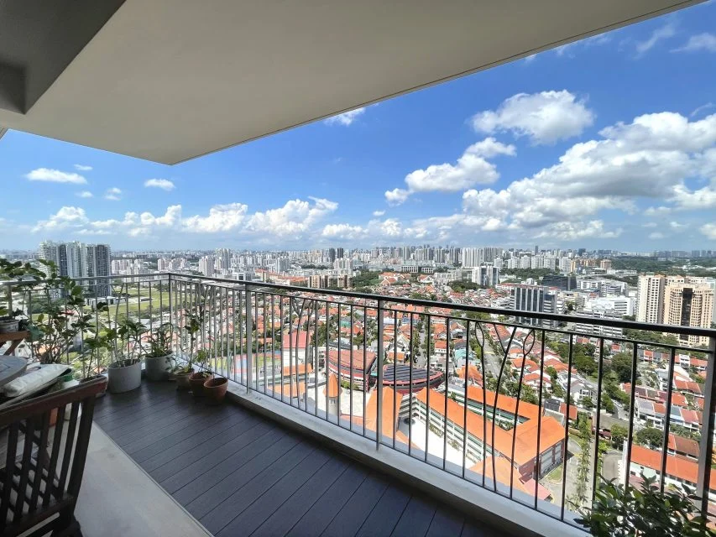
The view from the balcony of a Natura Loft resale flat that was sold for S$1.295 million last year. Image credit: Elson Wang. February 2022
Problem Statement
“This year, prices may not hit double-digit growth, given the cooling measures and more BTO launches on the cards,” Christine Sun says, Senior Vice President of Research & Analytics at OrangeTee & Tie. However, she adds that prices may rise again should the demand-supply situation persists. This can be due to the pandemic worsening such that a lockdown is necessary, although this possibility is quite unlikely.
Purpose
To understand the key factors affecting HDB resale prices
Solution
01
Demonstrate how unsupervised machine learning works with the clustering algorithm
02
Use clustering algorithms to find patterns in the HDB dataset
03
Explore insights on the dataset before clustering

Slide 5
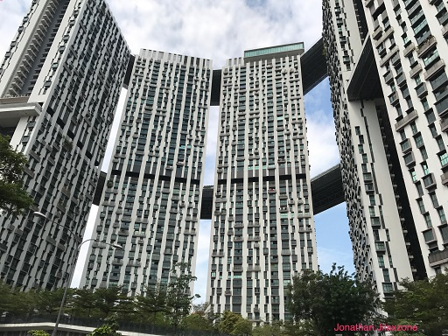
Data Collection
The data sources we used are publicly available sources and are easily found online. (i.e., data.gov.sg)
01
HDB Historical data on the address, flat information, and price of all resale transactions from 1990 to 2022, retrieved from https://data.gov.sg/dataset/resale-flat-prices
02
For the purpose of this project, the CSV file we will be using is called “resale-flat-prices-1990-2021-onward.csv”
03

Slide 6

Data Cleaning
In this step, we will run a data cleaning process where we will remove noisy data and duplicated rows
There are no null values in this dataset
1863 duplicated entries that could not serve in our analysis and perhaps might bias the exploratory data analysis.
Exploratory Data Analysis
All apartments’ floor areas (square meters) vary between 28 to 307sqm.
The mean floor area is 95.71sqm and the median floor area is 95sqm.
The oldest lease commence date is year 1966 and the most recent is year 2019.
Resale prices vary between SGD5000/- to SGD1,388,888.88.
The mean resale price is SDG30,4541.78
Explore each feature individually by plotting their distribution and see the influence of each feature on the resale price

Slide 7
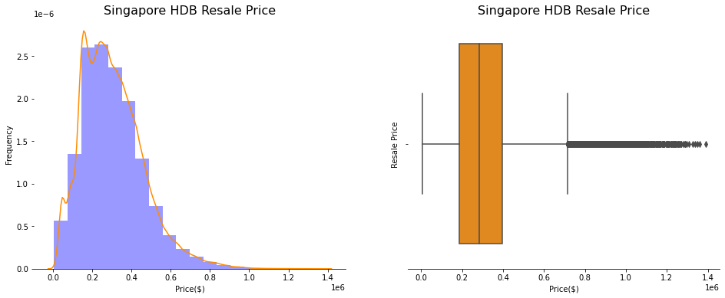
Singapore HDB Resale Price
Majority of the prices are between 200,000 to 800,000 SGD.
The histogram is not normally distributed, and it is right-skewed.
From the boxplot, we can see numbers of outliers after the maximum whisker, which explains the right-skewed of the histogram.

Slide 8
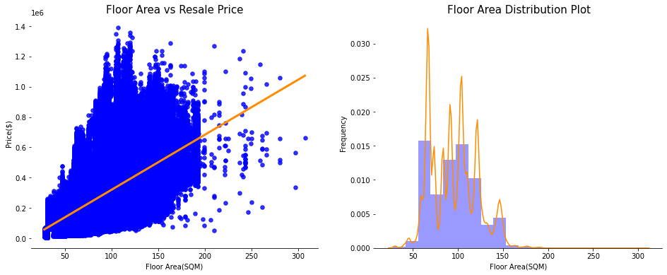
Floor Area vs Resale Price
Floor area increases, the resale price increase.
Most of the observations are between 40 to 200 sqm.
The HDB resale price seems to be the highest for the floor area between 100 to 125 sqm.
There are some outliers that should be removed.

Slide 9
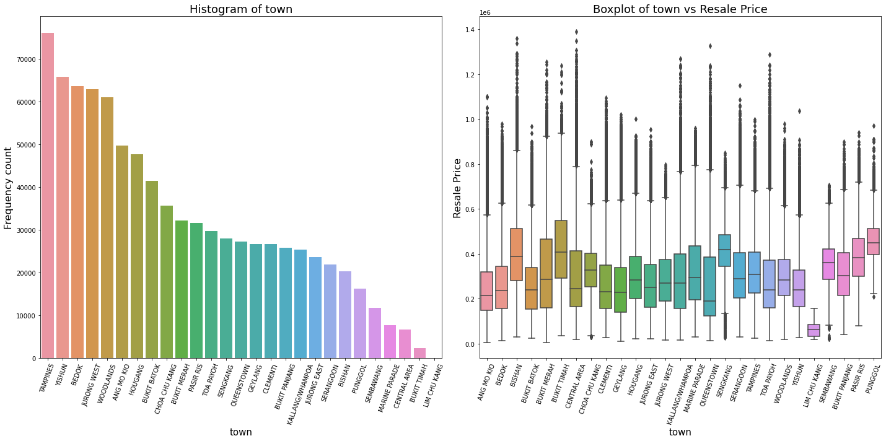
Town vs Resale Price
Tampines, Yishun & Bedok have the highest sale occurrences
The most expensive HDB area in the central area, Bukit Merah and Bishan

Slide 10
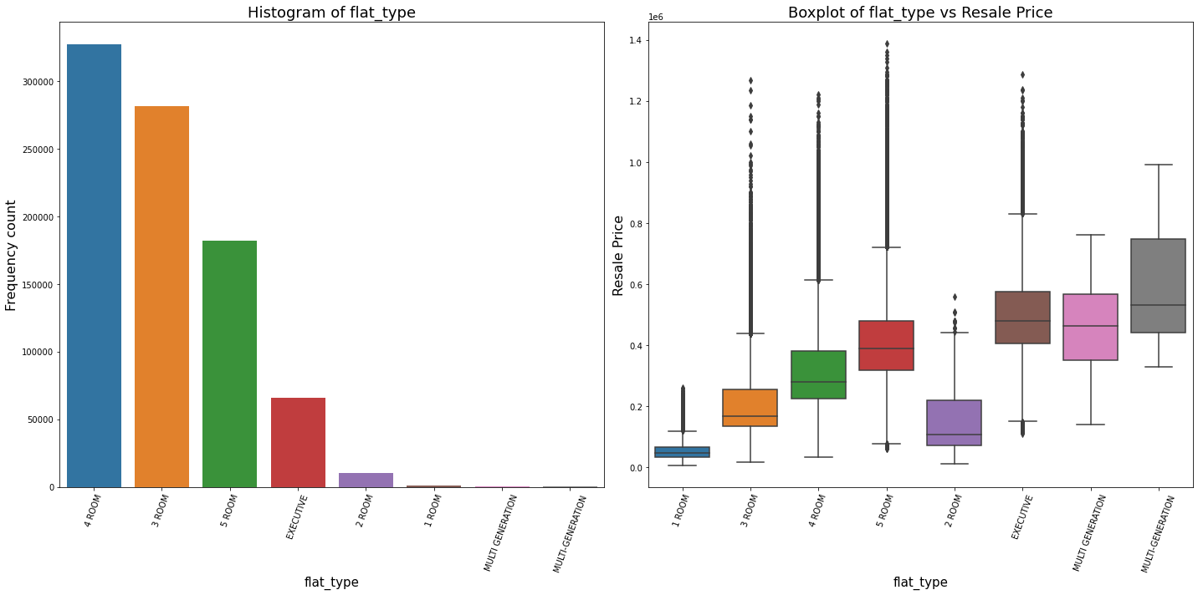
Flat Type vs Resale Price
There are much fewer 1 Room, 2 Room, Multi-Generation and Executive flats compare to 4 Room HDB flat
The most common flat type is 4 Room, 5 Room and 3 Room

Slide 11
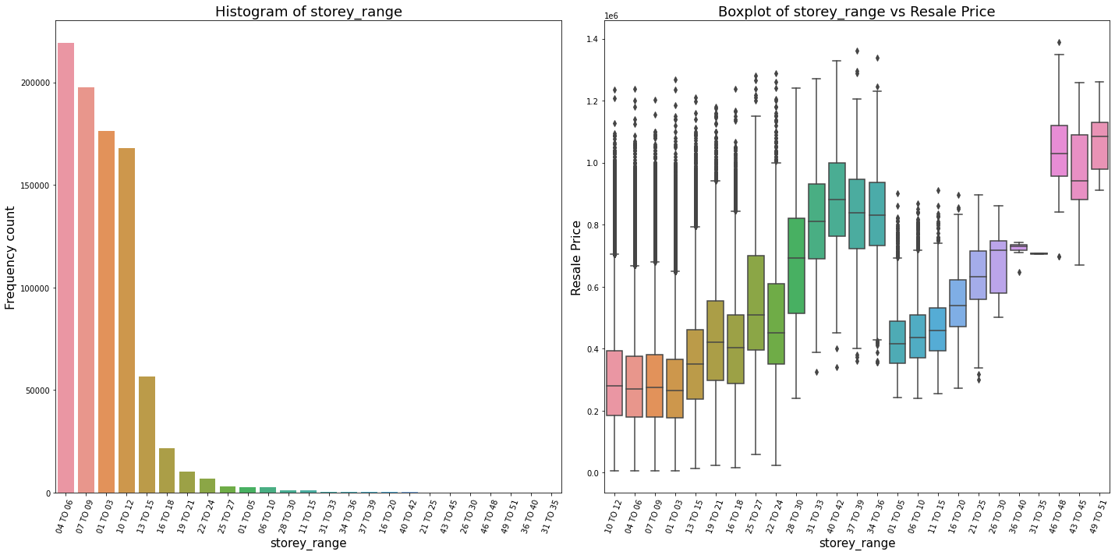
Storey vs Resale Price
Level 04 to level 06 have the highest sale occurrences
There is a clear upwards trend in the resale price for higher stories

Slide 12
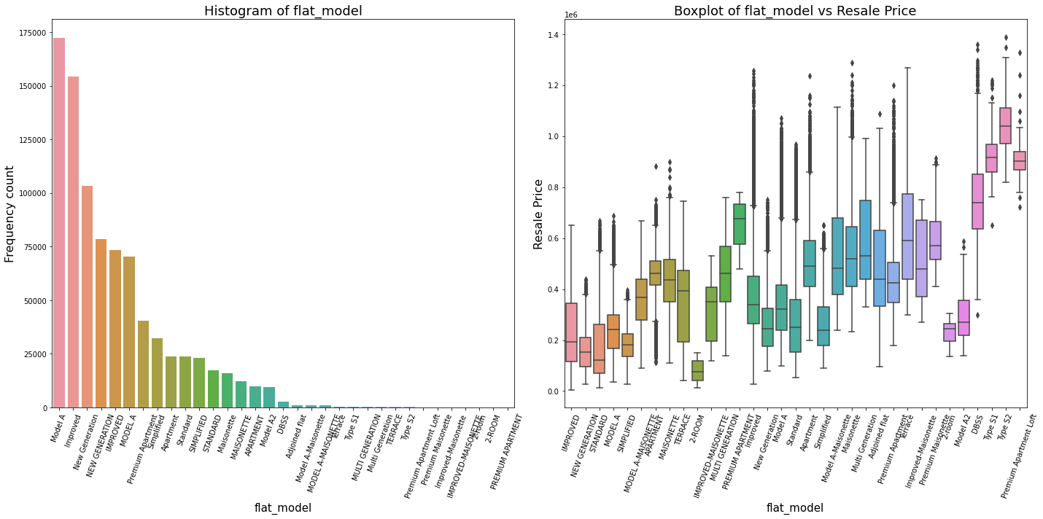
Flat Model vs Resale Price
Model A, Improved and New Generation are the most common HDB model.
Prices vary widely, which is probably due to some flat model size is smaller, poor design or old flat

Slide 13
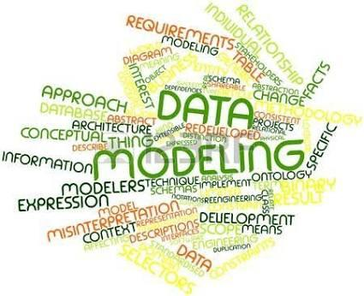
01
Feature Engineering
The aim of this task is to transform the existing features from their categorical format into a numerical format so that they could be fed into a Machine Learning model for clustering purposes.
02
K-means clustering
The most used approach is to set an interval of k clusters and then we start applying the k-means algorithm to check where the inertia value will get stabilized and stop decreasing, this is also called the Elbow line.
03
DBSCAN clustering
DBSCAN is a clustering algorithm and is part of the class of Unsupervised Learning algorithms. It allows us to select groups from datasets based on shared characteristics for samples within a particular group.
Epsilon Value (eps)
Minimum Points minPts
Types of Points in DBSCAN Clustering
Data Modeling

Slide 14
K-Means Clustering Approach
Transform Categorical Features to Numerical Ones
Drop Categorical Features with High Cardinality
Data Normalization
Find Optimal Number of Cluster = 4
Train K-Means Algorithm
Plot Clustering Results on 2-Dimensional Space
Categorical values to be transformed into numerical values for data modelling
town
flat_type
flat_model
street_name
Drop high cardinality features
town
block
street_name
The goal of normalization is to change the values of numeric columns in the dataset to a common scale, without distorting differences in the ranges of values
The approach is to set an interval of k clusters and then start applying the k-means algorithm to check where the inertia value will get stabilized and stop decreasing, this is also called the Elbow line
In this step, we will train a T-SNE model over a sample of our dataset just to make it faster to train, since it is very time-consuming and won't change too many insights on a sample of the original data
We will call the labels provided by the K-Means algorithm and give them more colorful annotations, so it makes it easier to interpret clusters between each other
01
02
03
04
05
06

Slide 15
DBSCAN Clustering Approach
01
02
03
04
05
06
Transform categorical features to numerical ones
Drop Categorical features with high cardinality
Find Optimal Value of Epsilon = 0.0776
Plot Clustering Results on 2-Dimensional Space
Data Normalization
Train DBSCAN Algorithm
Categorical values to be transformed into numerical values for data modelling
town
flat_type
flat_model
street_name
Drop high cardinality features
town
block
street_name
The goal of normalization is to change the values of numeric columns in the dataset to a common scale, without distorting differences in the ranges of values
To determine the location of maximum curvature visually can be difficult. Hence, a Python package called kneed can be used to detect the knee or elbow point.
Now that we have derived the optimal value of epsilon as 0.0776 and applied this in the DBSCAN algorithm.
This time it is quite evident that the DBSCAN clustering is done properly with 4 resulting clusters and only a few noise points
Estimated no. of clusters: 171
Estimated no. of noise points: 17,396

Slide 16
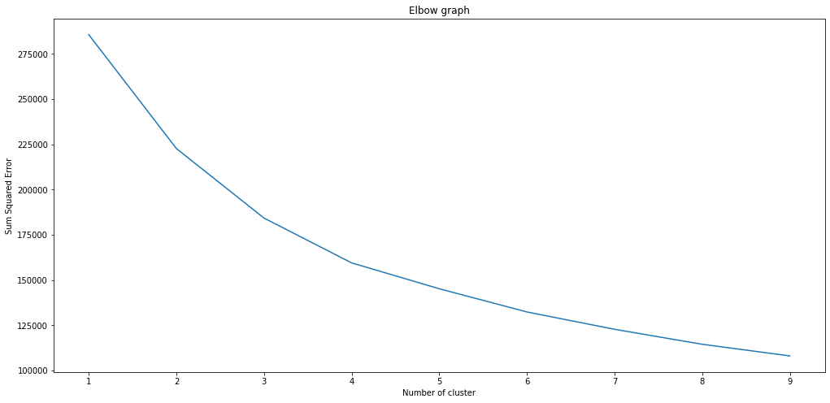
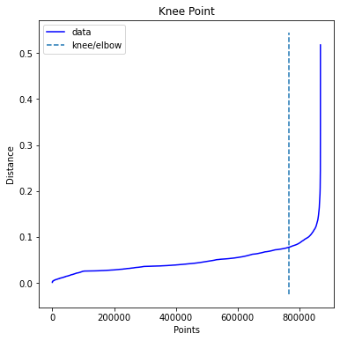
Types of Models
 | K-Means | DBSCAN
Optimal Hyperparameters | Silhouette Score = 0.5516 K = 4 | Epsilon = 0.0776
Visualization Space | T-SNE 2-Dimensional Space | T-SNE 2-Dimensional Space
Number of Clusters | 4 | 171
Hyperparameters Tuning

Slide 17
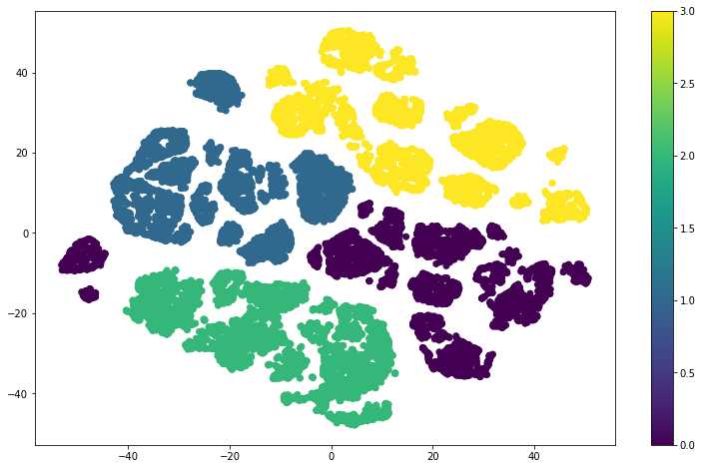
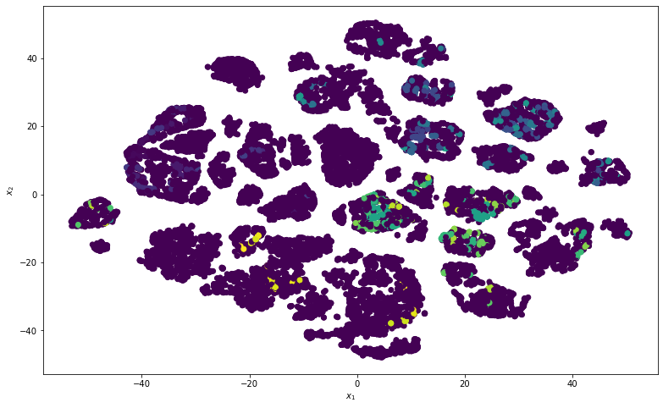
Unsupervised Machine Learning Results
K-Means
DBSCAN
We can say that our clustering process was very successful with the K-means, looking back at its results and how the data visualization helped us to gain insights into the unsupervised clustering model.
As we can see, the DBSCAN algorithm didn't perform better for data clustering and from the plot above we can clearly see how the data stayed in its noisy format and the DBSCAN model couldn't find patterns in the dataset.
By looking at the size of the given sample and the number of points that still represents a noise, we can conclude that the DBSCAN algorithm still needs further hyperparameters tuning to make it fit better.

Slide 18
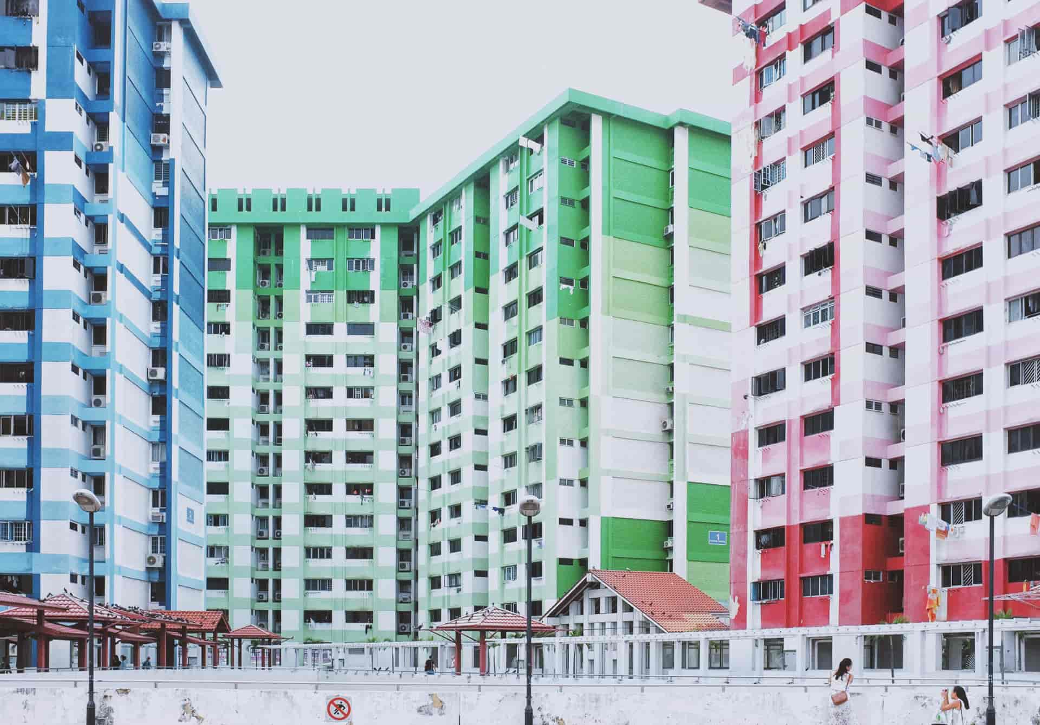
Future Steps
To improve results, we can recommend the following steps in the future:
01
Transform locations categorical data into Geolocations coordinates (latitude & longitude)
Accessibility: Time taken includes time to walk to the nearest MRT station and the travel time between the nearest MRT station and Raffles Place MRT station
Proximity to facilities: Proximity of the HDB flat to facilities such as primary school and shopping malls.
Town in which the flat is located: The more mature the town in which the flat is found, the higher the resale price.
Estate composition: Such as the % of working adults, % of older adults, % of young people in the estate
02
Try Principal Component Analysis to reduce the dimensionality of our dataset.
03
Hyper-parameters tuning for DBSCAN model.
04
Try different other clustering algorithms, e.g., K-NN, SVD, etc.

Slide 19


